Slide 1
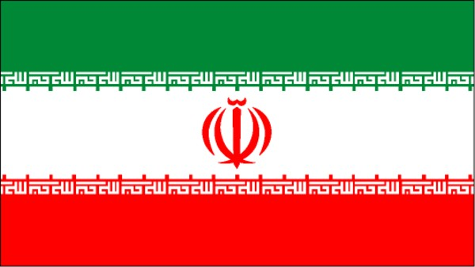
IRAN

Slide 2
Iran under
shah reza pahlavi
(1953-1979)

Slide 3
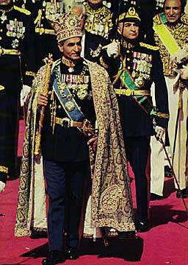
Shah Reza Pahlavi (r. 1941 – 1977)
Institutes Western reforms & ties with the West .
But, the majority of his people live in poverty.
Brutal suppression of dissidents → SAVAK
Q5

Slide 4
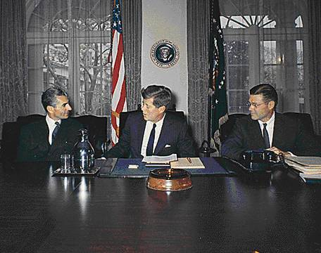
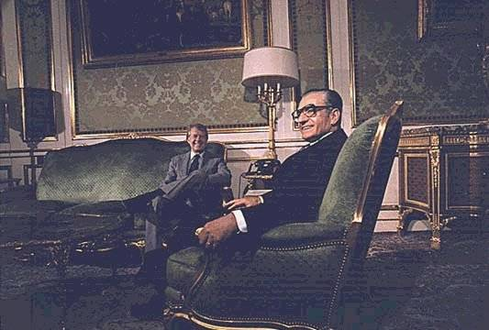
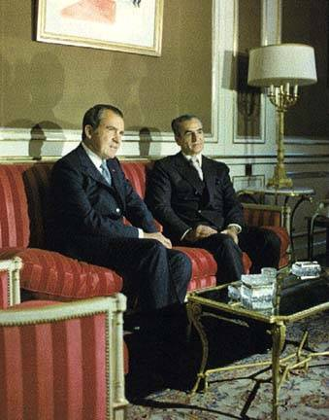
The Shah with Several American Presidents

Slide 5
Reasons for the Fall of the Shah
The Shah spent the oil profits for top of the line American military hardware.
Little money to reinvest back into the Iranian economy.
Religious leaders angry with the Shah for too much “Westernization.”
Government corruption.
The Shah’s constitutional violations of the basic human rights of his citizens.

Slide 6
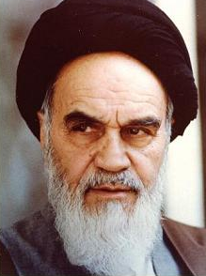
Ayatollah Khomeini (r. 1979-1989)
1902 – 1989.
Became an Islamic scholar (studied in Qom).
Began to speak out against the Shah in the 1960s.
Arrested and imprisoned several times by the Shah.
Deported in 1978 & went to France.

Slide 7
The
Islamic
Republic
of Iran

Slide 8
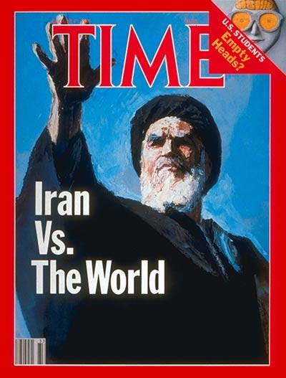
The Khomeini Revolution

Slide 9
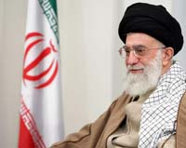
Iranian Supreme Leader Ayatollah Ali Khamenei
The Supreme Leader of Iran, Ayatollah Ali Khamenei who is the commander-in-chief of the armed forces of Iran and has the final word in all aspects of foreign and domestic policies.

Slide 10
Mahmoud Ahmadinijad
Current President of Iran

Slide 11
Mahmoud Ahmadinijad
He became president on August 6, 2005 after winning the presidential election by popular vote. He is the highest directly elected official in the country; however, according to the of Constitution of Iran, he has much less power than the Supreme Leader. This division of power would signify a ____________ form of government.
He has said Iran's nuclear program is for peaceful purposes and has refused to end enrichment despite United Nations Security Council resolutions.
He has called for the dissolution of the state of Israel and its government, which he does not regard as legitimate or representative of the population, and for free elections in the region. He believes that the Palestinians need a stronger voice in the region's future.
One of his most controversial statements was one in which, according to the initial IRNA translation, he called for Israel to be "wiped off the map," though the interpretation of this quote is highly questionable. He has also been condemned for describing the Holocaust s a myth which has led to accusations of anti-semitism.
PARLIMENTARY

Slide 12
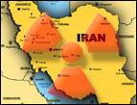
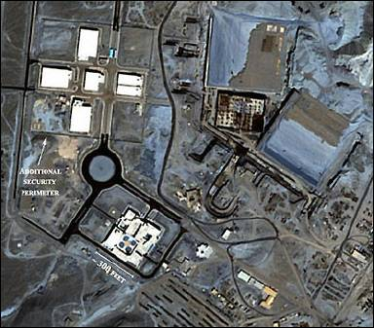
Another Nuclear Power?
US satellite photo of Iranian nuclear facility near Arak.

Slide 13
The
Iran-Iraq
War (1980-1988)

Slide 14
IRAQ

Slide 15
After WWI the ____________ took over the territory of the Ottoman Turks and established the country of ______
They made the ruler someone that was friendly to them but in the ______ he was overthrown by some military leaders.
British
Iraq
1950’s

Slide 16
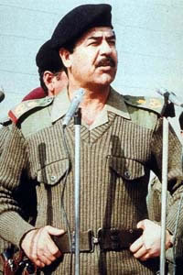
In 1979__________ __________ took control of the government. He was a very harsh ruler of the country who limited personal freedoms of the countries people, media, and even had many of his political enemies executed.
Saddam Hussein

Slide 17
Iran – Iraq War
in 1980, the Iran-Iraq war broke out because the two governments did not like each other, wanted each others oil supplies as well as water supplies.
There were over 1.5 million casualties
the US had to send warships in the area to protect their oil tankers from being attacked by one of the two sides
Although Iran was an enemy of the US, we secretly gave them arms during the Reagan years, which later lead to a major investigation here in the US
in 1988, the war ended with a tie

