Slide 1
The Great Leap
Forward (or Backward?)
1958-1961

Slide 2
Great Leap Forward, 1958
Set up a command economy which is what?
5 year plan to increase agriculture and industry Communes
Groups of people who live and work together
Property held in common
Had production quotas
Failed due to poor quality of products, poor weather hurt agriculture
Millions of Chinese starved during this period due to improper economic planning.

Slide 3
Communist China Under Mao
Industrialized China
Increased literacy
Class privileges ended
Rural Chinese received health care
One-party dictatorship
Denied people basic rights and freedoms --> Inner Mongolia, Tibet

Slide 4
Mao, Panchen Lama, Dalai Lama in Beijing, 1954
Tibet --> an autonomous area.
Tibet revolts against Chinese Government.
Dalai Lama fled in the late 1950s to India.

Slide 5
Communist governments officially do not allow religion for fear of rebellion.
Buddism which believe what?
Daoism which believe what?
Many times these religions are mixed with _____________
Christianity and Islam have many followers
Confucianism

Slide 6
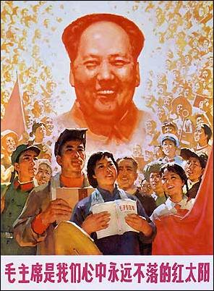
China under Mao
Mao launched the Cultural Revolution in 1966 as a response to threats to his power from fellow CCP members.
The Cultural Revolution created chaos throughout China, creating violence and driving many people to suicide. When Mao was informed of this issue, he allegedly commented: “People who try to commit suicide—don't attempt to save them! …China is such a populous nation, it is not as if we cannot do without a few people. ”
Mao declared the Cultural Revolution finished in 1969, but most historians cite Mao’s death in 1976 as the true end of the Revolution.
A Cultural Revolution poster featuring Mao as the “never-setting sun.”

Slide 7
Banned Items
Any books including Chinese, western or any Asian books that weren't about the communism and Mao Zedong
Nor any items that was linked or related to western culture.

Slide 8
Public Humiliation Trials
Pull hair
Force to drink water/ other liquids
Kneel in broken shards of glass
Have your alleged “crimes” called out to while kneeling in front of an audience
Public beating
Stoning
Hanging

Slide 9
The Little Red Book (1)
The Little Red Book also known as Quotations from Chairman Mao Zedong (毛主席语录) has been published by the government of the People’s Republic of China since 1964.
It is a collection of quotations excerpted from Mao Zedong's past speeches and publications.
900 million copies of The Little Red Book has been sold, second only to the bible which has been around much longer.
It was essentially an unofficial requirement for every Chinese citizen to own, to read, and to carry it at all times during the Cultural Revolution. The punishment for failing to produce the book upon being asked would range from being beaten by Red Guards to being given years of hard-labor imprisonment.
Studying the book was required in schools, as well as at workplaces. Workplaces have specified reading sessions during working hours for workers to study the book.
Notes:
Little red book, was a collection of past speeches of Mao Zedong.

Slide 10
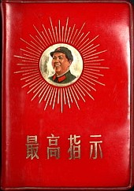

Slide 11
Propaganda Poster

Slide 12
