Slide 4
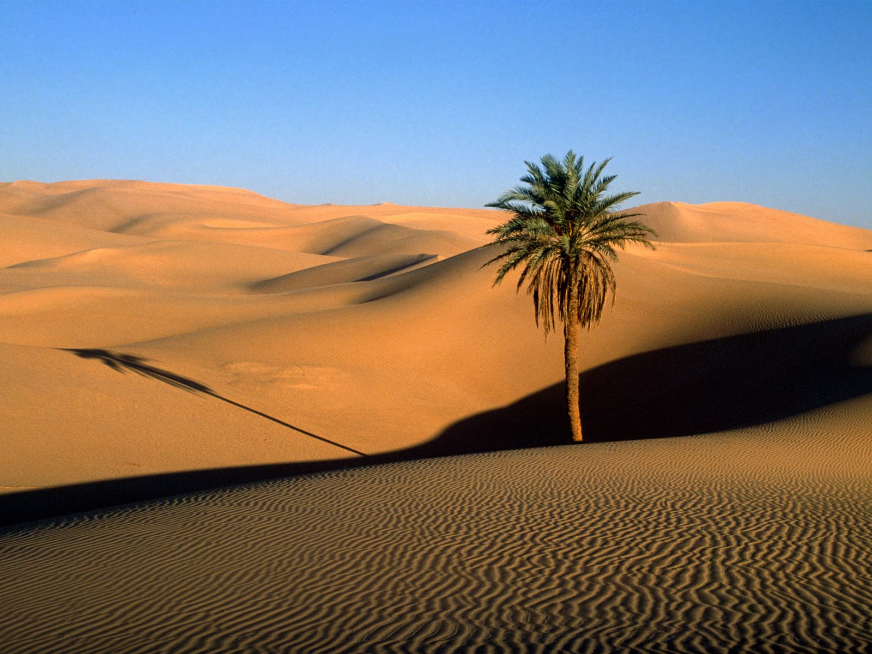
It covers an area the size of the US and very few people are able to live there.
In the few places where there is water, an oasis (a small place where trees are able to grow and where people can live with grazing animals and a few crops) can be found.
Such places are rare in the Sahara Desert.
Parts of the Sahara Desert are hot and dry, with very little rainfall.
Many consider the Sahara one of the most difficult places to live on earth.
The Sahara divides the continent into two regions: North Africa and sub-Saharan Africa

Slide 5
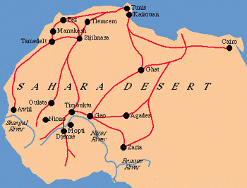
People of the Sahara
Most of the people who live in the Sahara today are nomads.
They move from place to place, usually traveling by camel, looking for water or food.
Nomadic tribes often trade with each other as they try to fill the needs of their group.
These desert nomads were the ones who led the caravan trade across the Sahara in the years before airplanes and desert vehicles were available.
Hundreds of years ago, gold and salt came across the Sahara on the backs of camels from central Africa to markets along the Mediterranean coast.

Slide 6
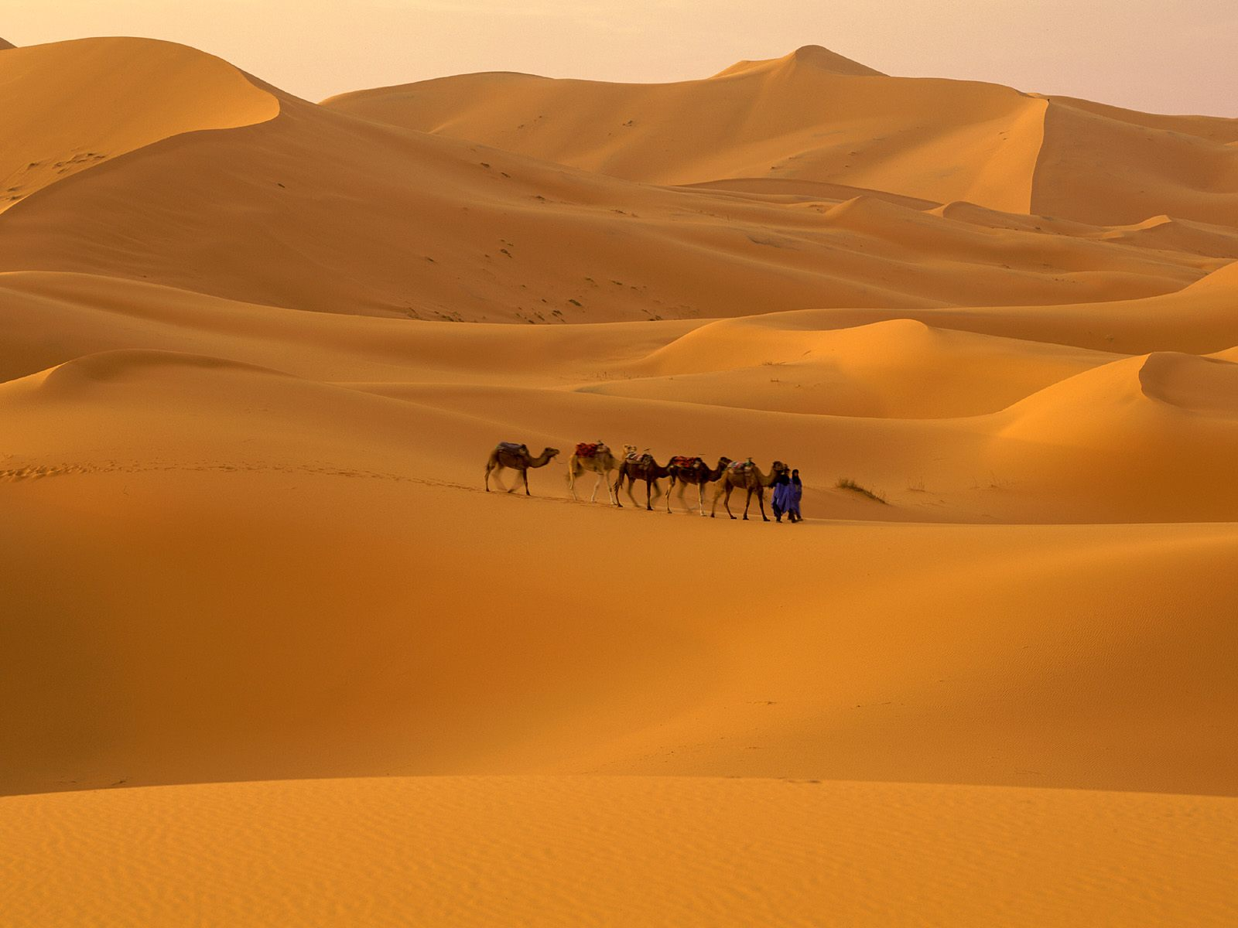
Trade goods from the coast then made the return journey.
Even today, there are parts of the Sahara that are virtually impossible to get across without a camel.
Some of the nomadic tribes who live in the Sahara have been there for centuries.
Today many of these tribes are finding it difficult to make a living in traditional ways, and many have settled down to live in small villages and towns where they can find steady work.

Slide 7
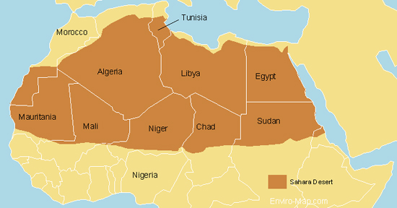
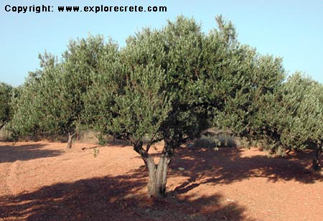
What can grow in the Sahara?
Despite its harsh environment, the Sahara is home to a number of plants that can tolerate desert conditions.
Those areas that do get a little rainfall or that have access to underground water often have grasses and shrubs as well as palm trees, olive trees, and cypress.

Slide 8
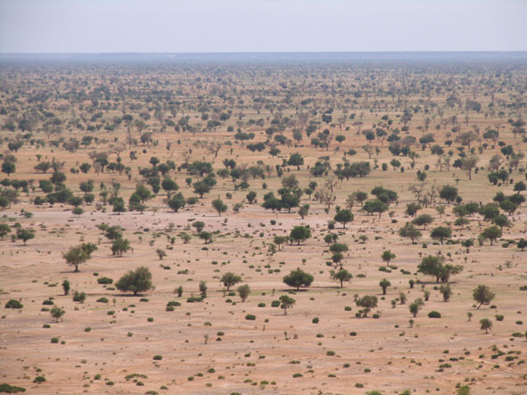
However, the region’s cities are too poor to accommodate the population increase.
Many people continue to live without electricity, running water, or proper sewers.
The desert gradually took over the farmland the people left behind.
Desertification is the process of once fertile farmland turning into desert.
Desertification reduces the amount of crops that can be grown, increases starvation, and maintains poverty.

Slide 9
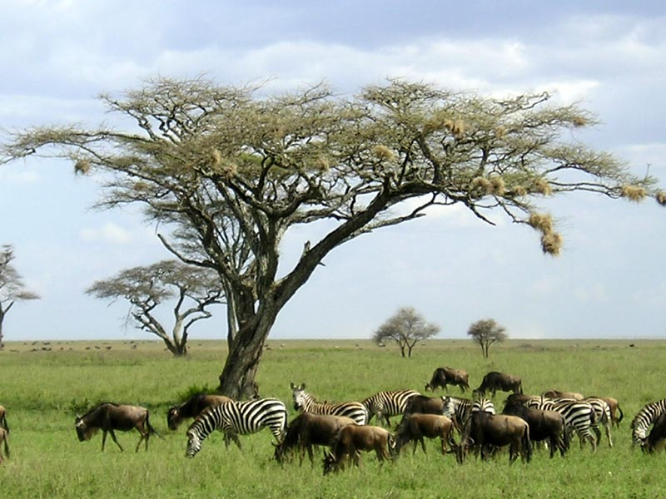
The most famous savannah is the Serengeti, a migration areas for 1.5 million animals like buffalo, gazelles, and zebras.
The Serengeti includes parts of Kenya, where people rely on the land for their livelihood.
About one-third of the country is grazing land for cattle, goats, and sheep.
Many Kenyans make a living growing coffee and tea, which are the country’s major exports.
Many of the wild animals associated with Africa live in the savannas.
Although the soil is rich, farming is the savannas is limited because of disease carrying insects.

Slide 10
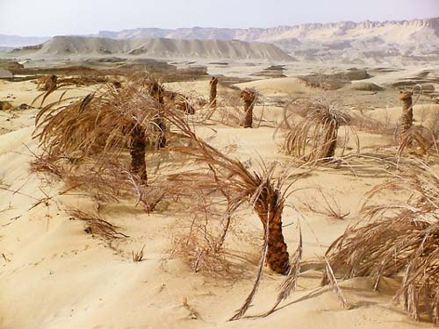
The word Sahel means “border” or “margin,” and this is the region that borders the Sahara.
It is a region between the desert to the north and the grasslands and rainforest to the south.
The Sahel is relatively flat with few mountains and hills.
While there is more rain than in the Sahara desert, rainfall in the Sahel varies from year to year, ranging from 6-20 inches.
Vegetation is sparse in the Sahel, and grasses and shrubs are unevenly distributed.

Slide 11
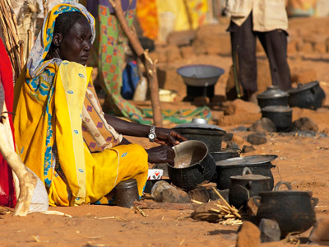
People in the Sahel
A majority of the people living in the Sahel follow traditional ways of making a living, herding animals and living semi-nomadic lives.
They move when water and grass run out for their animals.
Others practice subsistence farming, meaning they grow just enough food for their families.
Some grown peanuts and millet to sell in the market places, but undependable rain makes farming difficult.
Many of the countries in the Sahel have rapidly growing populations.
This is a problem since food and water are often scarce.

Slide 12
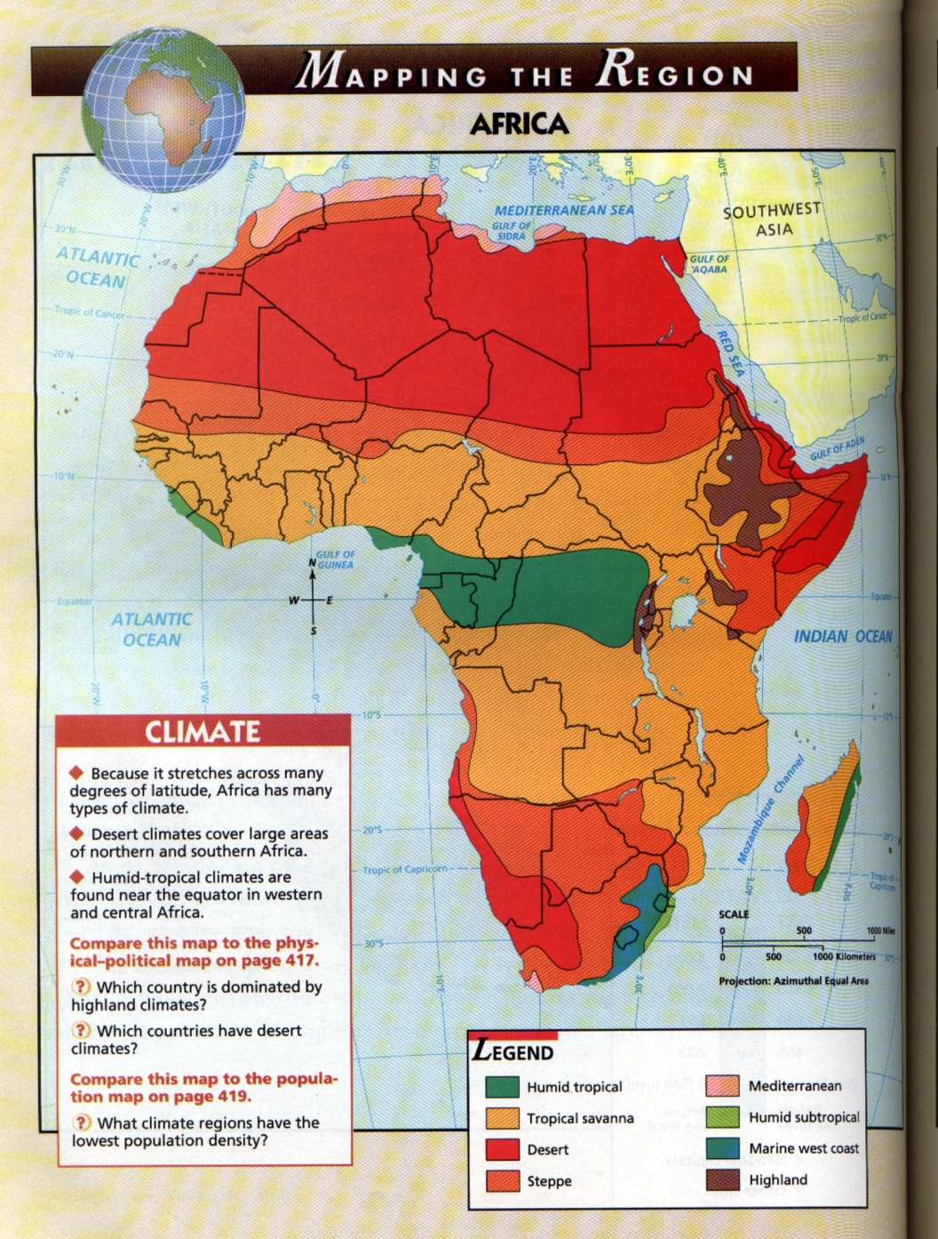
The savannah
Closer to the equator, the climate becomes hot and features both rainy and dry seasons.
Savannas cover the regions just north and south of the rainforests that lie along the equator.
Savannas are hot, dry grasslands.
In a savanna, the grass it tall and thick.
Trees are short and scattered.

Slide 13
The most famous savannah is the Serengeti, a migration areas for 1.5 million animals like buffalo, gazelles, and zebras.
The Serengeti includes parts of Kenya, where people rely on the land for their livelihood.
About one-third of the country is grazing land for cattle, goats, and sheep.
Many Kenyans make a living growing coffee and tea, which are the country’s major exports.
Many of the wild animals associated with Africa live in the savannas.
Although the soil is rich, farming is the savannas is limited because of disease carrying insects.

Slide 14
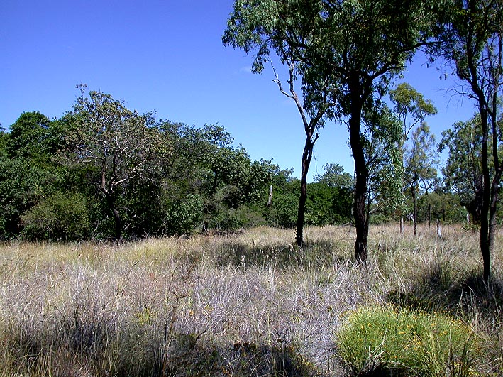
Usually there is not enough water to sustain trees and forests.
Grasses and grains like wheat, oats and sorghum grow in the region, too.
The African savanna is the largest in the world.
It covers almost half of Africa.
When the summer rains come, the savanna is green and the grass is thick.
During the winter dry season, the grasses turns brown and grass fires occur.
These fires are part of the natural cycle of life in the savanna.

Slide 15
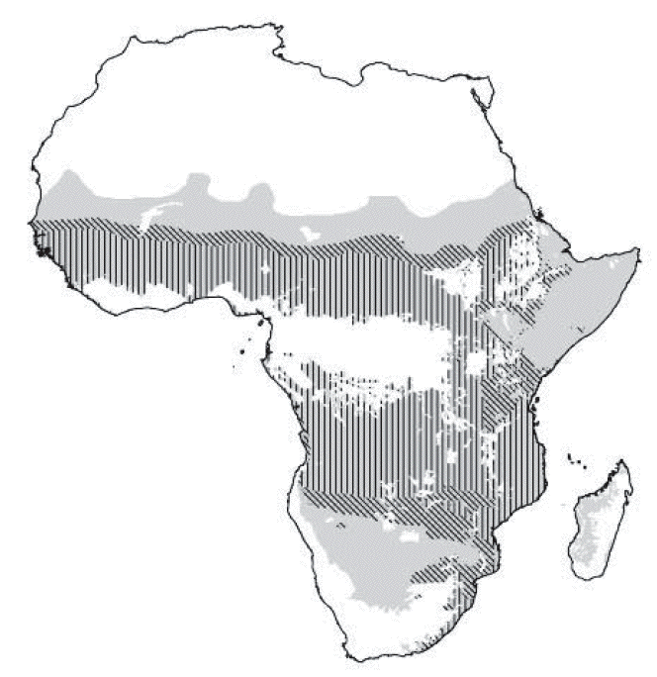
People in the savanna
The biggest threat to the African savanna is the increasing number of people.
The increasing population in Africa has put pressure on people to open more land for farming and ranching.
Every year, more savanna grassland is fenced in and plowed for crops.
Expanding farmlands mean less land for the animals.
Some countries, like Kenya and Tanzania, are working to set aside large areas of the savanna as national parks and game preserves.
The savanna regions of Africa have faced pressure from the growth of towns and cities and the need for highways to connect urban areas.
As roads are built through isolated savanna wilderness, natural animal habitats disappear.

Slide 16
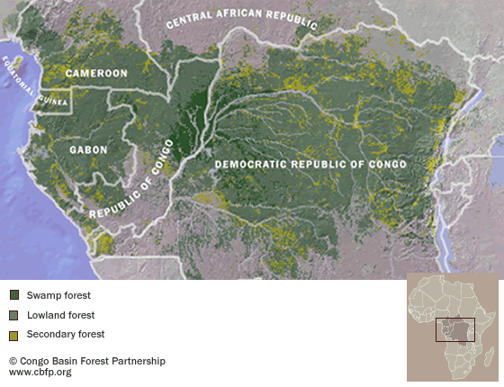
Rainforest
Along the equator lies the Congo Basin, home to the world’s second largest tropical rainforest (the Amazon is the largest).
A rainforest, is a dense evergreen forest with an annual rainfall of at least 60 inches.
In the Congo, trees are so thick and tall that sunlight never reaches the forest floor.
Unfortunately, the rainforest has shrunk substantially because of deforestation and destructive farming practices.

Slide 17
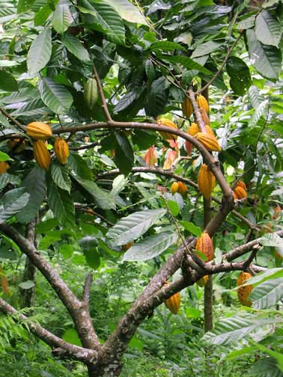
Rainforests are found in parts of the world that are warm and humid and usually in an area near the earth’s equator.
Part of the rainforest is in Ghana, an agricultural and mining nation.
Ghana’s most profitable crop is cocoa.
It also has a long history as a gold and diamond exporter.
Poorly maintained roads make transportation difficult in Ghana, which has slowed the growth of the timber industry.

Slide 18
Lake Victoria (bordered by Uganda, Kenya, and Tanzania) is the largest.
Lake Tanganyika (located between the DR Congo and Tanzania) is the deepest.
The Congo River is the second longest river in Africa.

Slide 19
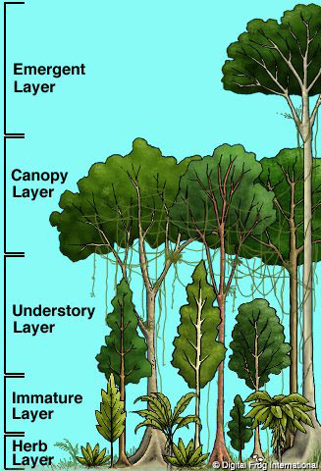
What makes the rainforest tick?
There are several levels to life in the rainforest.
The floor of a rainforest is one to thousands of varieties of insects, including many types of butterflies.
These butterflies play an important role in pollinating the flowers and making it possible for them to reproduce.
The rivers and streams in a rainforest support fish, alligators, and crocodiles.
Moving higher and up into the trees, one finds the canopy layers of the rainforest, home to birds, frogs, toads, and snakes, as well as monkeys and chimpanzees.
Rainforest canopies grow in multiple layers, with taller trees shading those at lower levels and allowing a wide variety of plants and animals to grow.

Slide 20
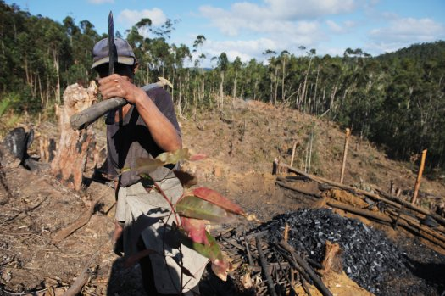
The people of the rainforest
For most of Africa’s history, the rainforests have been home to small groups of people who lived by gathering food from the forest or living on small subsistence farms.
They lived simple lives that had little impact on their environments.
In the 1800s, that changed when European nations discovered the riches in the rainforests.
Land was cleared for great plantations, including those that harvested rubber for Europe’s industrial revolution.
Thousands of the people who had lived in the rainforests were forced to work on these plantations and their traditional ways of life began to disappear.

Slide 21
Rainforest today
Today, the rainforests continue to be destroyed, but now the cause is commercial logging.
This destruction of the rainforest is called deforestation.
Timber cutting businesses also need roads and heavy equipment to get the trees they cut to cities.
These roads destroy more of the natural environment.
Deforestation leads to the extinction of species of both plants and animals.
Extinction means that those species no longer exist anywhere in the world.
Destruction of the forests contributes to soil erosion and desertification.

Slide 22
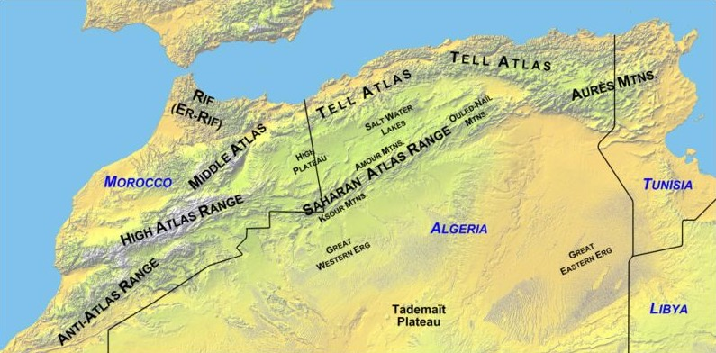
Atlas Mountains
This mountain range separates the temperate coastal areas of Morocco, Algeria, & Tunisia from the harsh Sahara Desert.

Slide 23
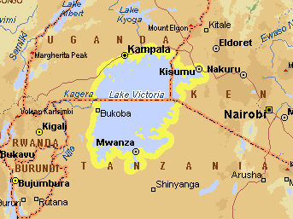
Lake Victoria
It is the largest lake in Africa and the second largest freshwater lake in the world (only Lake Superior is bigger).
It extends into three countries: Tanzania, Uganda, and Kenya.
Lake Victoria is very important to Tanzania.
It provides a living for many fishermen and attracts millions of tourists each year.

Slide 24
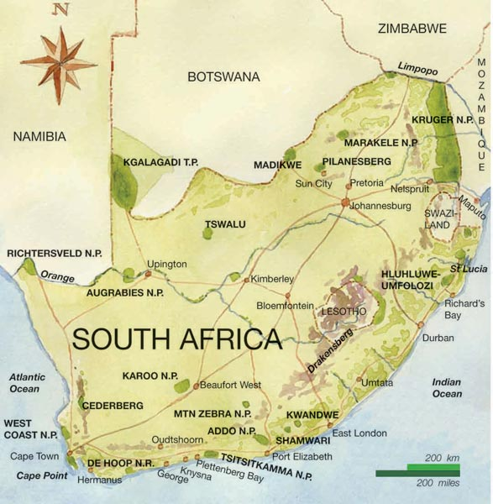
The Drakensberg Mountains stretch across Southern Africa.
They are home to many game reserves and national parks.
Another notable feature of the region is the Kalahari Desert.
Thanks to underground water supplies, grass, shrubs, and a number of wild animals manage to live in the Kalahari Desert

