Slide 1
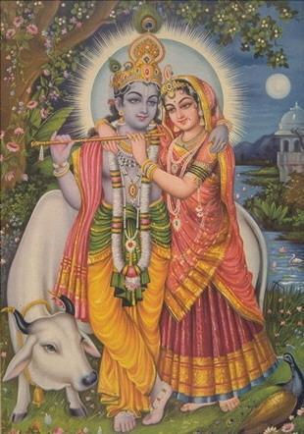
Hinduism
Hinduism Video

Slide 2
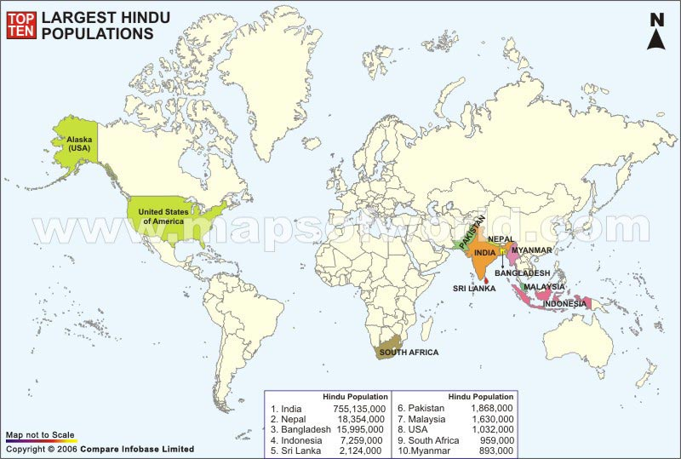
World Population
900 million

Slide 3
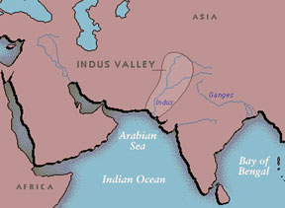
origins
Hinduism is made up of a variety of different religious beliefs and practices which originated near the river Indus in India.
The name 'Hindu' comes from the word Indus.
The religion dates back over 4,000 years.
World’s oldest major religion

Slide 4
Founder of Hinduism?
Hinduism does not have any founder or any prophets.

Slide 5
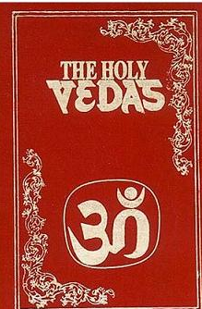
Sacred texts
the Vedas, a collection of hymns praising the Vedic gods
Upanishads : holy book from 8th century BC the Ramayana, long epic poems about Rama and Sita
the Mahabharata, which includes the Bhagavad Gita
the Puranas, a collection of stories about the different incarnations and the lives of saints.

Slide 6
Question from your reading:
What was written first the Vedas or the Vedic Text?
The Vedas

Slide 7
Major beliefs
the belief in Brahman, the universal soul, or God, which is found in everything. Brahman is worshipped in a variety of forms, including Vishnu, Krishna, Rama, Shiva and several others
salvation is achieved through a spiritual oneness of the soul, atman, with the ultimate reality of the universe, Brahman
To achieve this goal, the soul must obtain moksha, or liberation from the samsara, the endless cycle of birth, death, and rebirth – to obtain moksha is the main goal of all Hindus
Thus, Hindus believe in reincarnation (after someone dies, their soul lives on and starts a new life in another body – not necessarily a human one), which is influenced by karma (every action has an effect and there is a cause for everything), and dharma (fulfilling one's duty in life)
This means that, depending on how you have behaved in the previous life (generating good or bad Karma), you will be reborn into a better or worse life

Slide 8
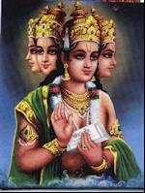
Who do Hindus worship? – the major gods of the Hindu Pantheon
Brahma, the creator god

Slide 9
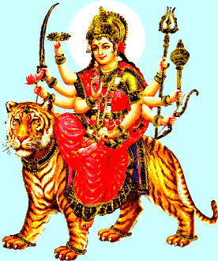
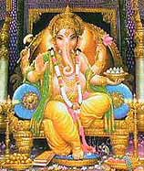
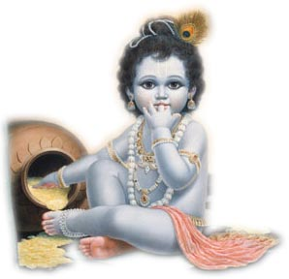
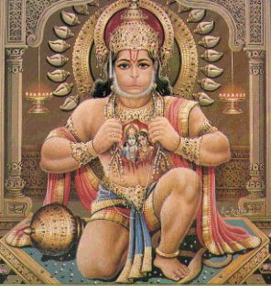
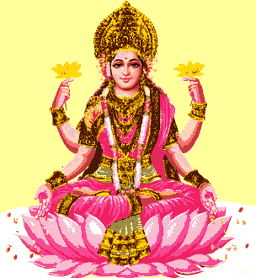
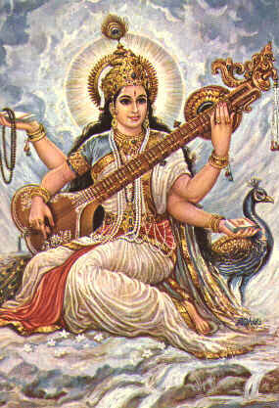
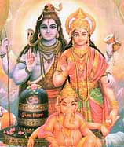
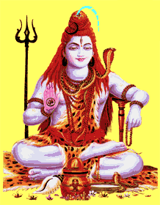
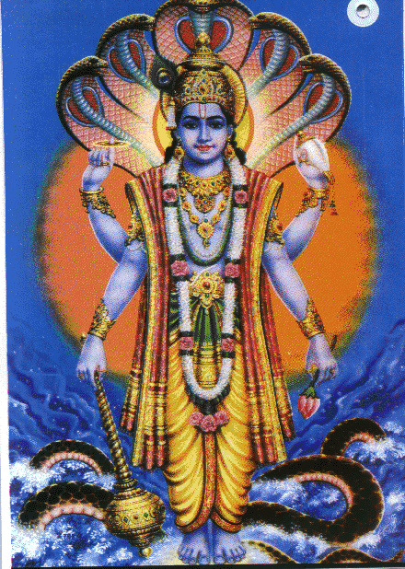
All these deities are but
Manifest forms (attributes
and functions) of the
impersonal Brahman

Slide 10
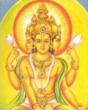
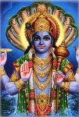
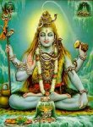
The 3 most important Hindu gods are:
Brahma - known as the Creator.
Vishnu - Known as the Preserver
Shiva (Siva)- known as the Destroyer.
Brahma
Vishnu
Shiva

Slide 11
And we too are manifest forms of God!
“We are not human beings having spiritual experiences; We are spiritual beings having a human experience!”
“That art Thou”
Hinduism is about recognizing the all pervasiveness of the divine

Slide 12
How do Hindus achieve Moksha
There are four different paths to achieve Moksha which a Hindu can take.
The Hindu can choose one or all four of the paths they are:
1 The path of knowledge - Jnana-Yoga
Spiritual knowledge -leading to the knowledge of the relationship between the soul (atman) and God (Brahman)
2 The path of meditation - Dhyana-yoga
The idea is to concentrate so you can reach the real self within you and become one with Brahman
3 The Path of Devotion - Bhakti-yoga
Choosing a particular god or goddess and worshipping them throughout your life in actions, words and deeds.
4 The path of good works - Karma-yoga
This involves doing all your duties correctly throughout your life.

Slide 13
Question from your reading:
What does the term Karma mean?
The effects that good or bad actions have on your soul

Slide 14
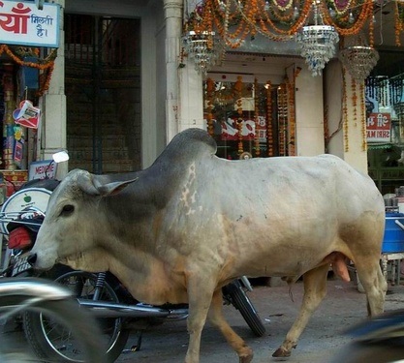
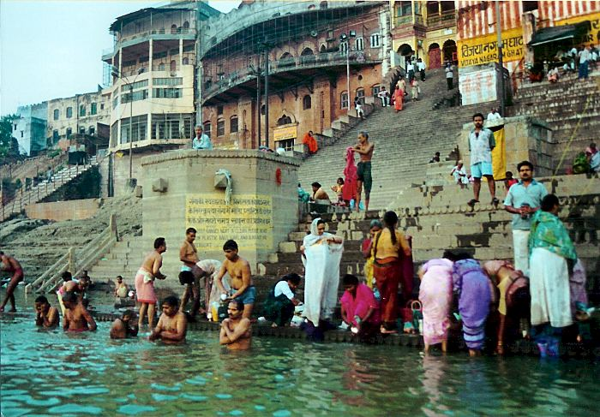
Everyday practices
Puja: worship either at temple or shrine at home
Arti: worship that takes place in front of statues of the gods – offerings given
Ahimsa: all life is sacred – so many are vegetarian
Cows are especially sacred – give freely of themselves (work, milk)
Holy Place – river Ganges (used for spiritual cleansing, funeral rites, and other Hindu rituals) – city of Varanasi
Festivals – Holi, Diwali
Belief in reincarnation, karma, and dharma provides the religious justification for the existence of the rigid social structure known as the Caste System

Slide 15
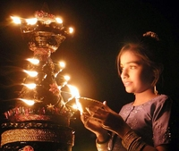
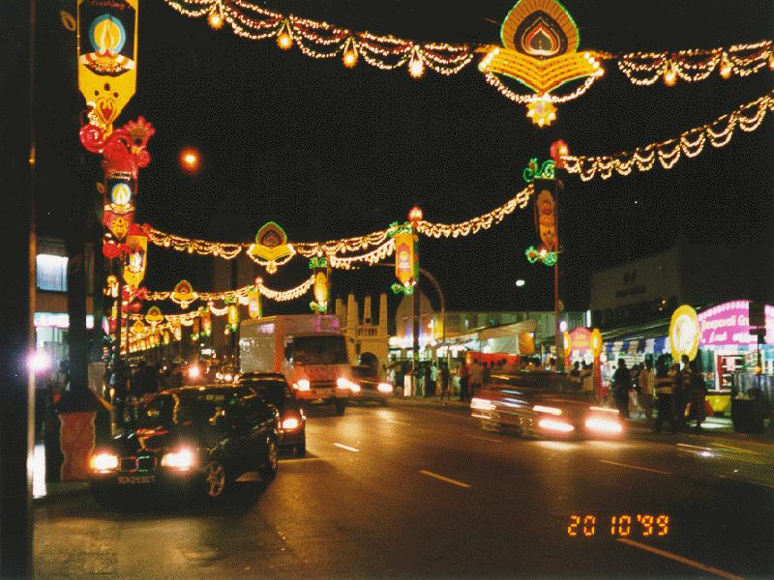
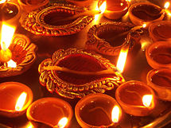
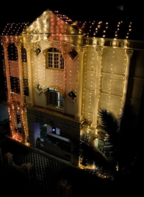
Diwali
Hindu festival of lights “row of lights” lasting five days.
b/c there are many regions in India, there are many forms of the Diwali festival
In at least one region, the “row of lights” are lit on the new-moon night to welcome Lakshmi, the goddess of wealth (In the Indian culture, wealth is not viewed as a corruptive power. Instead, a wealthy person is considered to have been rewarded for good deeds of a past life).
homes are thoroughly cleaned, windows are opened candles and lamps are lit to welcome Lakshmi. Gifts are exchanged and festive meals are prepared during Diwali. Celebration means as much to Hindus as Christmas does to Christians.

Slide 16
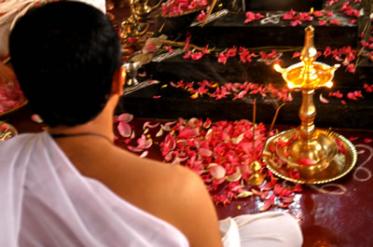
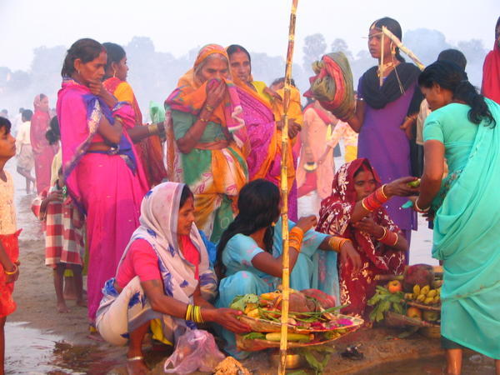
Dharma or Daily Duties
1. | Worshipping God: Hindus must devote part of their day to worship. This ensures spiritual contact.
2. | Reciting scripture: By reciting from a sacred text, the faithful learn the lessons of worldly and religious life.
3. | Honoring to parents and elders: Hindus are very loyal family members. Parents and elders are honored for their wisdom and self-sacrifice.
4. | Helping the poor: Even the less fortunate try to obey this commandment. Guests, in particular, are given special attention in a Hindu home.
5. | Feeding animals: Because Hindus consider all life a sacred part of one God, animals are respected and cared for.

Slide 17
Question from your reading:
What is the act of being reborn over and over known as?
Reincarnation

Slide 18
Varna (Social Hierarchy)
Priest
Brahmins
Kshatriyas
Warriors
Vaishyas
Merchants/Landowners
Shudras
Commeners/peasents/servants
Pariahs [Harijan] → Untouchables

Slide 19
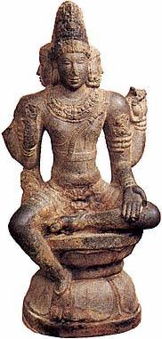
The Caste System
Brahmins
WHO IS…
Kshatriyas
The mouth?
The arms?
The legs?
The feet?
Vaishyas
Shudras

Slide 20
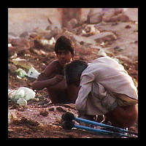
Untouchables (Dalits) of India
The Hindu religion prescribes that the Dalits themselves accept their own oppression. Belief in reincarnation demands that they conform to their religion if they are to progress to higher status in another life.
The system persists outside India too. In Western countries and in Africa, wherever Indian populations exist, so does caste.

Slide 21
Question from your reading:
What factors determine if a person is reborn?
A persons actions during his/her lifetime-Karma

Slide 22
Ashrama: Four Stages of Life
1-20 Years Old
The student, who is devoted and obedient to his teacher
The householder, who supports his family and the priests and fulfills duties to the gods and ancestors
The hermit, or retiree who withdraws from society to pursue ascetic and yogic practices
The guru, who renounces all possessions and wanders from place to place begging for food

Slide 23
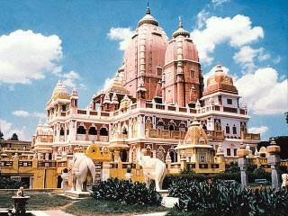
Place of worship
Worship takes place in Mandirs (temples)
There are formal gatherings for worship but people can also visit the Mandir at any time to pray and participate in the bhajans (religious songs).
Hindus will also worship at home and often have a special room with a shrine to particular gods.

Slide 24
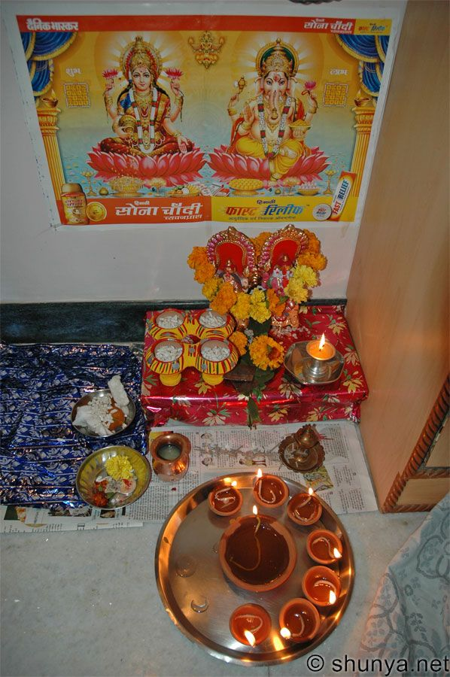
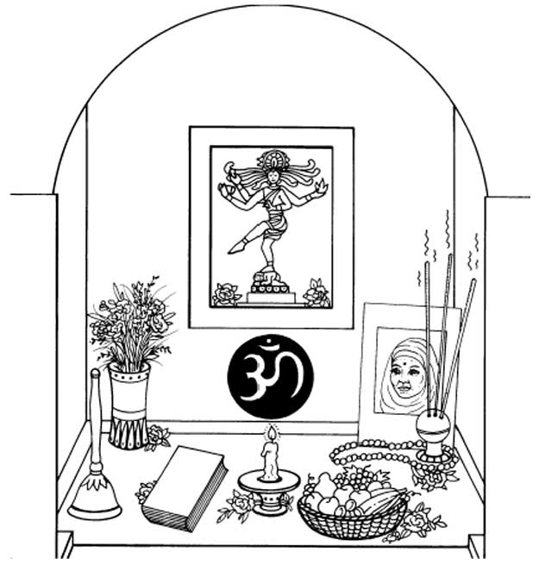
Home Shrines
Almost all Hindus keep a shrine in their home, regardless of their caste or economic status.
Shrines are dedicated to a particular god,
Vary in size. Some families can afford to leave aside an entire room while others can devote only a corner of the bedroom. The sacred space, like the shrine of a temple, is tended to religiously.
family members worship collectively or individually.
common features of a family shrine:
- On a table or shelf rests a photograph of the chosen god. The fragrance of fresh flowers and fruit mixes with incense and perfumes in the air. A bell, which is rung for prayer, stands nearby. An oil lamp, lit during worship, sits beside the scripture from which prayers are read. Other symbols, gods, and gurus may also appear in the shrine.

Slide 25
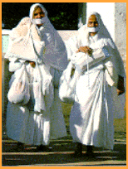
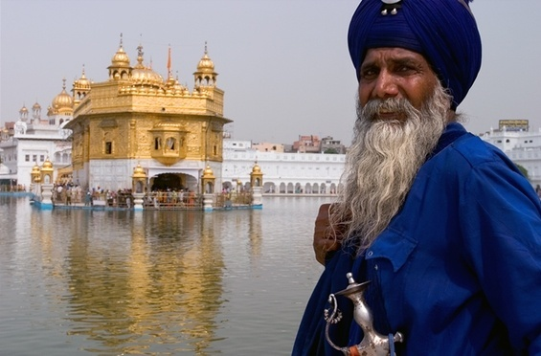
Religious Divisions
Sikhism - elements of Islam & Hinduism
Jainism - concern for life is extended to all creatures, even minute microbes that are not visible

