Slide 1
Buddhism

Slide 2
World Population
Country | Percent
Thailand | 95%
Cambodia | 90
Myanmar | 88
Bhutan | 75
Sri Lanka | 70
Tibet * | 65
Laos | 60
Vietnam | 55
Japan ** | 50
Macau | 45
Taiwan | 43
appx. 376 m
** 4th largest
The Largest Buddhist Communities
Top 10 Countries with the Highest Proportion of Buddhists

Slide 3
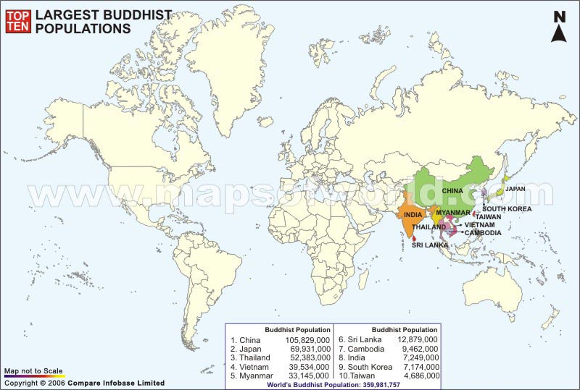
Buddhism: world distribution

Slide 4
Origins
developed in India 2500 yrs ago
based on many of the core concepts of Hinduism
essence of Buddhism is the attainment of enlightenment
points to a way of life that avoids self-indulgence and self-denial.
no supreme god or deity in Buddhism

Slide 5
Question from your reading:
Who was the founder of Buddhism?
Siddhartha Gautama

Slide 6
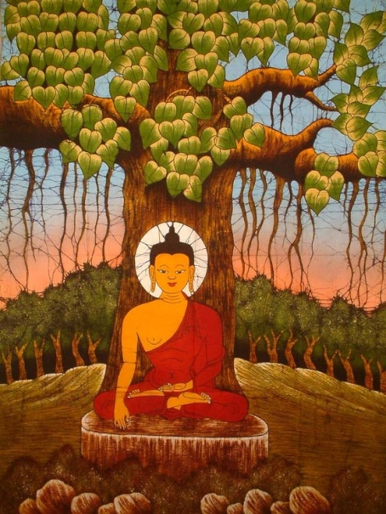
founder
Siddhartha Guatama, or Buddha which means “enlightened one”
lived in the 5th century BC
born into the Brahmin caste-led a luxurious lifestyle.
Became troubled by the human misery that he saw around him everyday.
Upon reflection, he deduced that desire was the root caused of all suffering (enlightened under a Bodhi Tree)
not considered a god by his followers

Slide 7
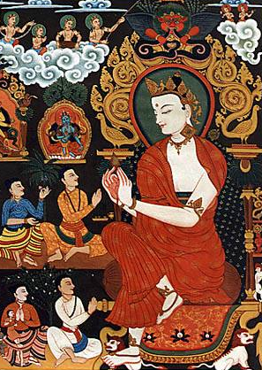
Siddhartha Gautama (563-483 BC)
Born in NE India (Nepal).
Raised in great luxury to be a king.
At 29 he rejected his luxurious life to seek enlightenment and the source of suffering.
Lived a strict, ascetic life for 6 yrs.
Rejecting this extreme, sat in meditation, and found nirvana.
Became “The Enlightened One,” at 35.

Slide 8
What is the fundamental cause of all suffering?
Desire!
Therefore, extinguish the self, don’t obsess about oneself.

Slide 9
Four Noble Truths
There is suffering in the world. To live is to suffer. (Dukkha)
The Buddha found this out when he was young and experienced suffering and death in others.

Slide 10
Four Noble Truths
The cause of suffering is self-centered desire and attachments. (Tanha)

Slide 11
Question from your reading:
What is the term for a state of “Perfect Peace”?
Nirvana

Slide 12
Four Noble Truths
The solution is to eliminate desire and attachments. (Nirvana = “extinction”)

Slide 13
Four Noble Truths
To reach nirvana, one must follow the Eightfold Path.

Slide 14
Major Beliefs
The Four Noble Truths Siddhartha's philosophy of the nature of human suffering and its relation to desire is articulated by these four statements:
Life is full of pain and suffering.
Human desire causes this suffering.
By putting an end to desire, humans can end suffering.
Humans can end desire by following the Eightfold Path.

Slide 15
Eightfold Path
Nirvana
The union with the ultimate spiritual reality.
Escape from the cycle of rebirth.

Slide 16
The Eightfold Path
Wisdom
Right View – know the truth
Right Intention – resist self-centeredness
Ethical Conduct
Right Speech – refrain from unkind, negative speech
Right Action – respect all life
Right Livelihood – work for the good of others
Mental Discipline
Right Effort – exert oneself in freeing the mind of evil (egocentric thought)
Right Awareness – elevate one’s thoughts beyond the haze of emotion and mood
8) Right Meditation – practice the discipline of meditation

Slide 17
3. Reincarnation
concept that one must go through many cycles of birth, living, and death
After many such cycles, if a person releases their attachment to desire and the self, they can attain Nirvana - a state of liberation and freedom from suffering
Nirvana can be achieved from meditating and following the guiding principles of Buddhism, such as the Four Noble Truths, 8-fold path

Slide 18
4. Karma - the law that every cause has an effect, i.e., our actions have results. This explains a number of things: inequality in the world, why some are born handicapped and some gifted, why some live only a short life. Buddhists believe that our are past actions have an effect on who or what we are in our next life.
5. Caste System is rejected by Buddhists

Slide 19
Symbols of Buddhism
Wheel of Life: represents the endless cycle of life through reincarnation. Each of its eight spokes represents one of the teachings of the Eightfold Path.
Lotus Flower: symbolizes purity and divine birth. The different color lotus flowers have specific meanings: for example, the red lotus signifies the qualities of the heart while the purple lotus is the mystic lotus.

Slide 20
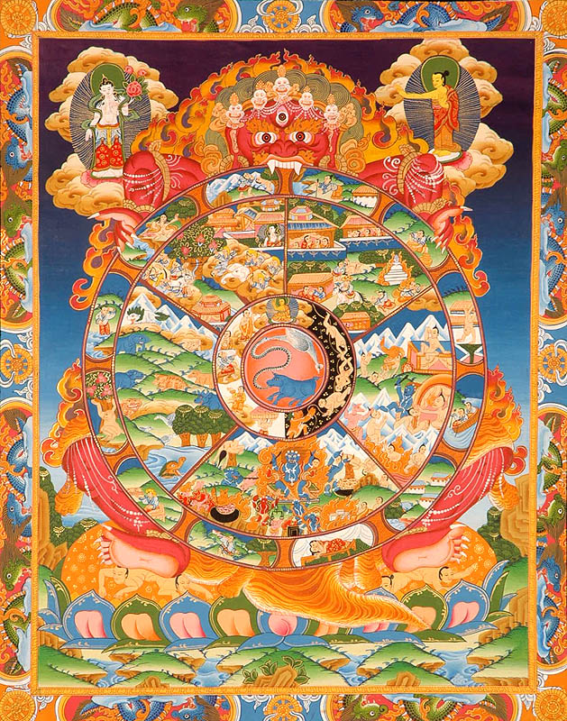
An Example of a
Wheel of Life

Slide 21
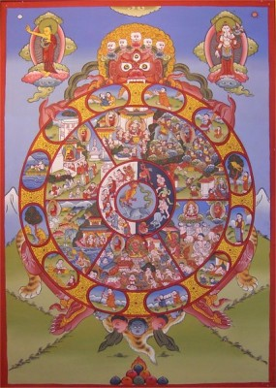
An Example of a
Wheel of Life

Slide 22
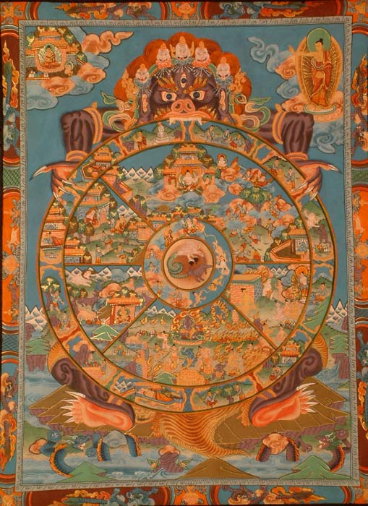
An Example of a
Wheel of Life

Slide 23
Everyday practices
Live by this moral code:
Do not take the life of anything living
Do not take anything not freely given
Abstain from sexual misconduct and sensual overindulgence
Refrain from untrue speech
Avoid intoxication
Do not lose mindfulness
Meditation:
training the mind to empty it all of thoughts. When this happens what is important comes clear

Slide 24
Question from your reading:
What is a person who works to spread their religious beliefs?
A missionary

Slide 25
Religious Divisions
Theravada Buddhism - found in Burma, Thailand, Sri Lanka, Laos, Cambodia, Myanmar & in part, Indonesia, Vietnam & Malaysia.
Mahayana Buddhism - found in China, Japan, Korea and Vietnam.
Vajrayana Buddhism - found in Tibet, Nepal, Sikkim, Bhutan and Mongolia
Jodo Shin Buddhism or Pure Land Buddhism - mainly from India, Japan
Zen Buddhism - mostly in Japan

Slide 26
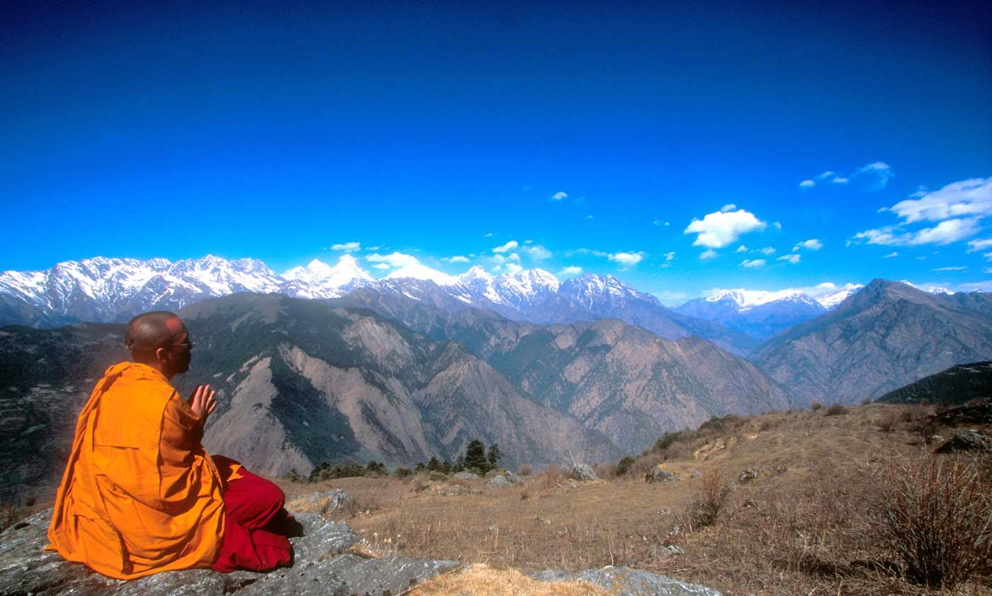
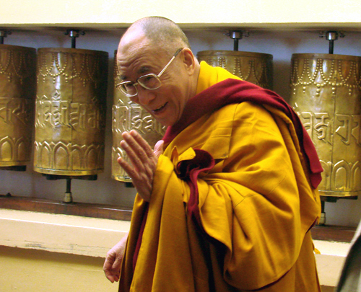
Spiritual leaders
Monks
Significant leader today: Dalai Lama (Tibetan Buddhism)

Slide 27
Question from your reading:
Who is the main god of Buddhism
There are no Gods, Not even Buddha himself

Slide 28
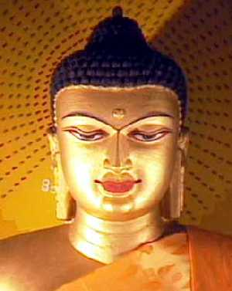
The Many images of Buddha
Statues of Buddha may include up to 32 symbols.
Any # of these symbols can be used on statues.
(For example, the Buddha is often shown with a bump on on the top of his head. This is a symbol that he had special talents. He is often seen with a round mark on his forehead, which is his third eye. This is a symbol to show that he could see things ordinary people cannot see. He may be shown with curled hair, which is a symbol that he was a very holy man. Sometimes he has long ears, which is a symbol that he came from an important family, and also that he could hear things that other people could not.

Slide 29
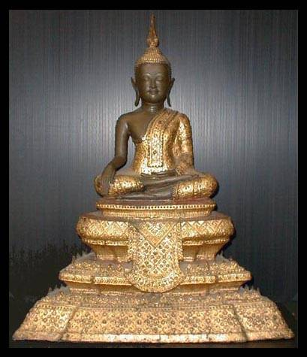
Buddha – 19c Thailand

Slide 30
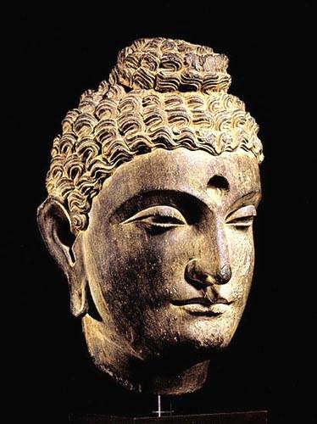
Buddha’s head :
2c Pakistan

Slide 31
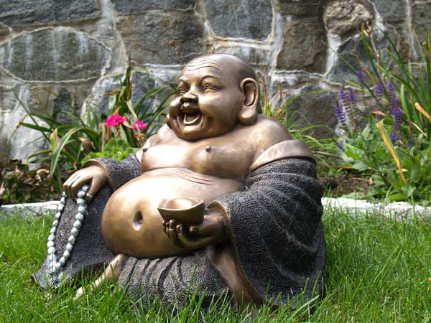
This does not represent Buddha (how do you know?)
The legend of the Laughing Buddha

