Slide 1
Japan part 2

Slide 2
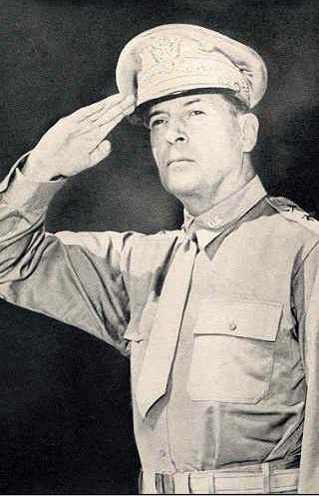
US Occupation-MacArthur
Does not try Hirohito for war crimes because he is a popular figure for the people of Japan.
Begins food relief efforts for the people of Japan at the cost of over a million dollars a day.
Helps set up a democracy by helping draft a US style constitution-Hirohito is a figure head but has no real power.
Insist that Japan be allowed into trade alliances.

Slide 3
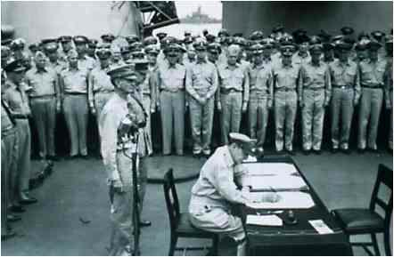
Postwar Japan
The Allies, under the command of US General Douglas MacArthur, oversaw
Japan and the drafting of a new
constitution after WWII.
The new constitution established a democratic government, reduced the size of Japan’s military to a defensive force, and allowed for a modified version of the emperor. It also guaranteed certain human rights and extended women the right to vote.
In 1951, Japan became independent again. However, it kept a close relationship with the US.
The US poured lots of money into rebuilding Japan and helped it grow economically. Today, Japan is one of the wealthiest and economically strongest nations in the world.

Slide 4
Outcomes for Japan
Japan has a modern economic miracle.
Best educated work force in the world.
Women granted rights
Old power structure, and class system broken down and replaced.
Peasants could and did own property.
Democracy still reigns to this day.

Slide 5
What is the reason for Japan’s economic success?
The Government
Their Work Ethic
Their Tariffs
Their Trade Surplus

Slide 6
What is the name for Japan’s legislature?
The Diet

Slide 7
What type of government does Japan have?
Constitutional Monarchy

