Slide 1
Japan’s Modern History
Notes:
The next couple of slides are a comparison of the countries that we will be visiting. Notice how small all are compared to China.

Slide 2
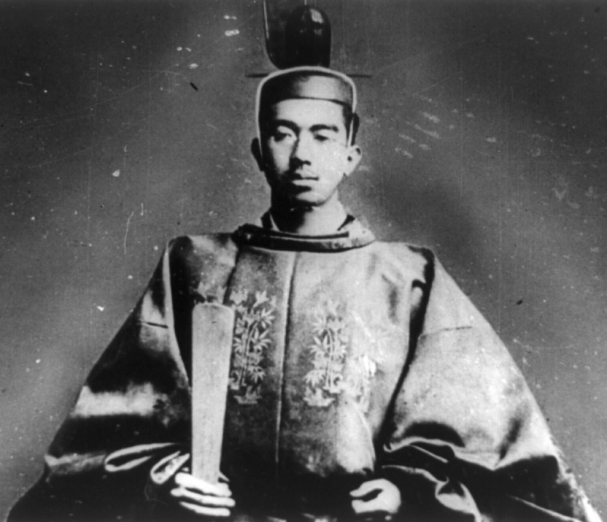
The emperor through out most of the Twentieth Century was __________________
Emperor Hirohito

Slide 3
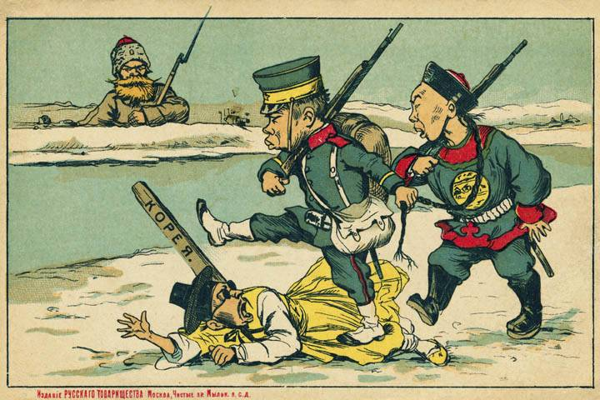
Japan Annexes Korea

Slide 4
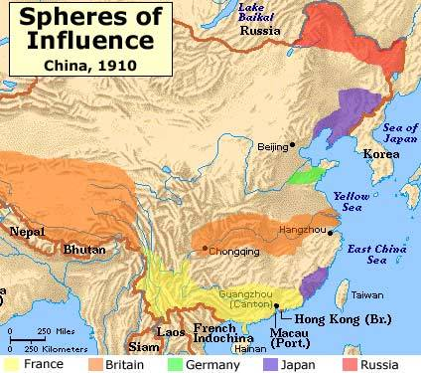
Japan Is a Player in China

Slide 5
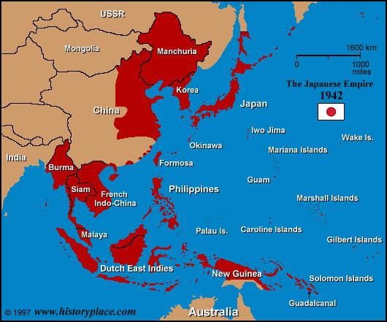
Review:
1) Manchuria Incident (1931): Ultranationalist take over democracy, military fakes attack on Jap. railroad in Chinese Manchuria, Jap invades.
2) Japan Invades Rest of China (1937): KMT forced to join with CCP to fight Japan.

Slide 6
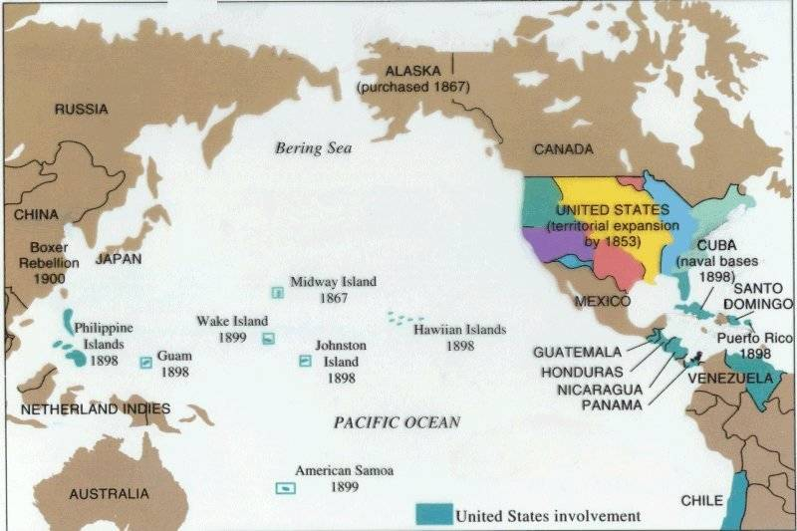
Competition from Another “Pacific” Power Is on the Horizon

Slide 7
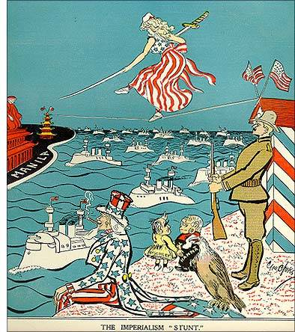
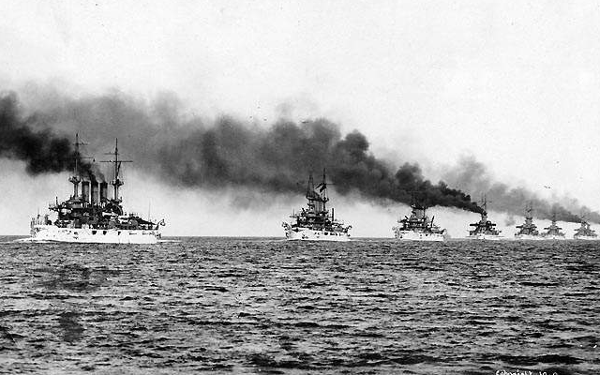
The U. S. “Great White Fleet”

Slide 8
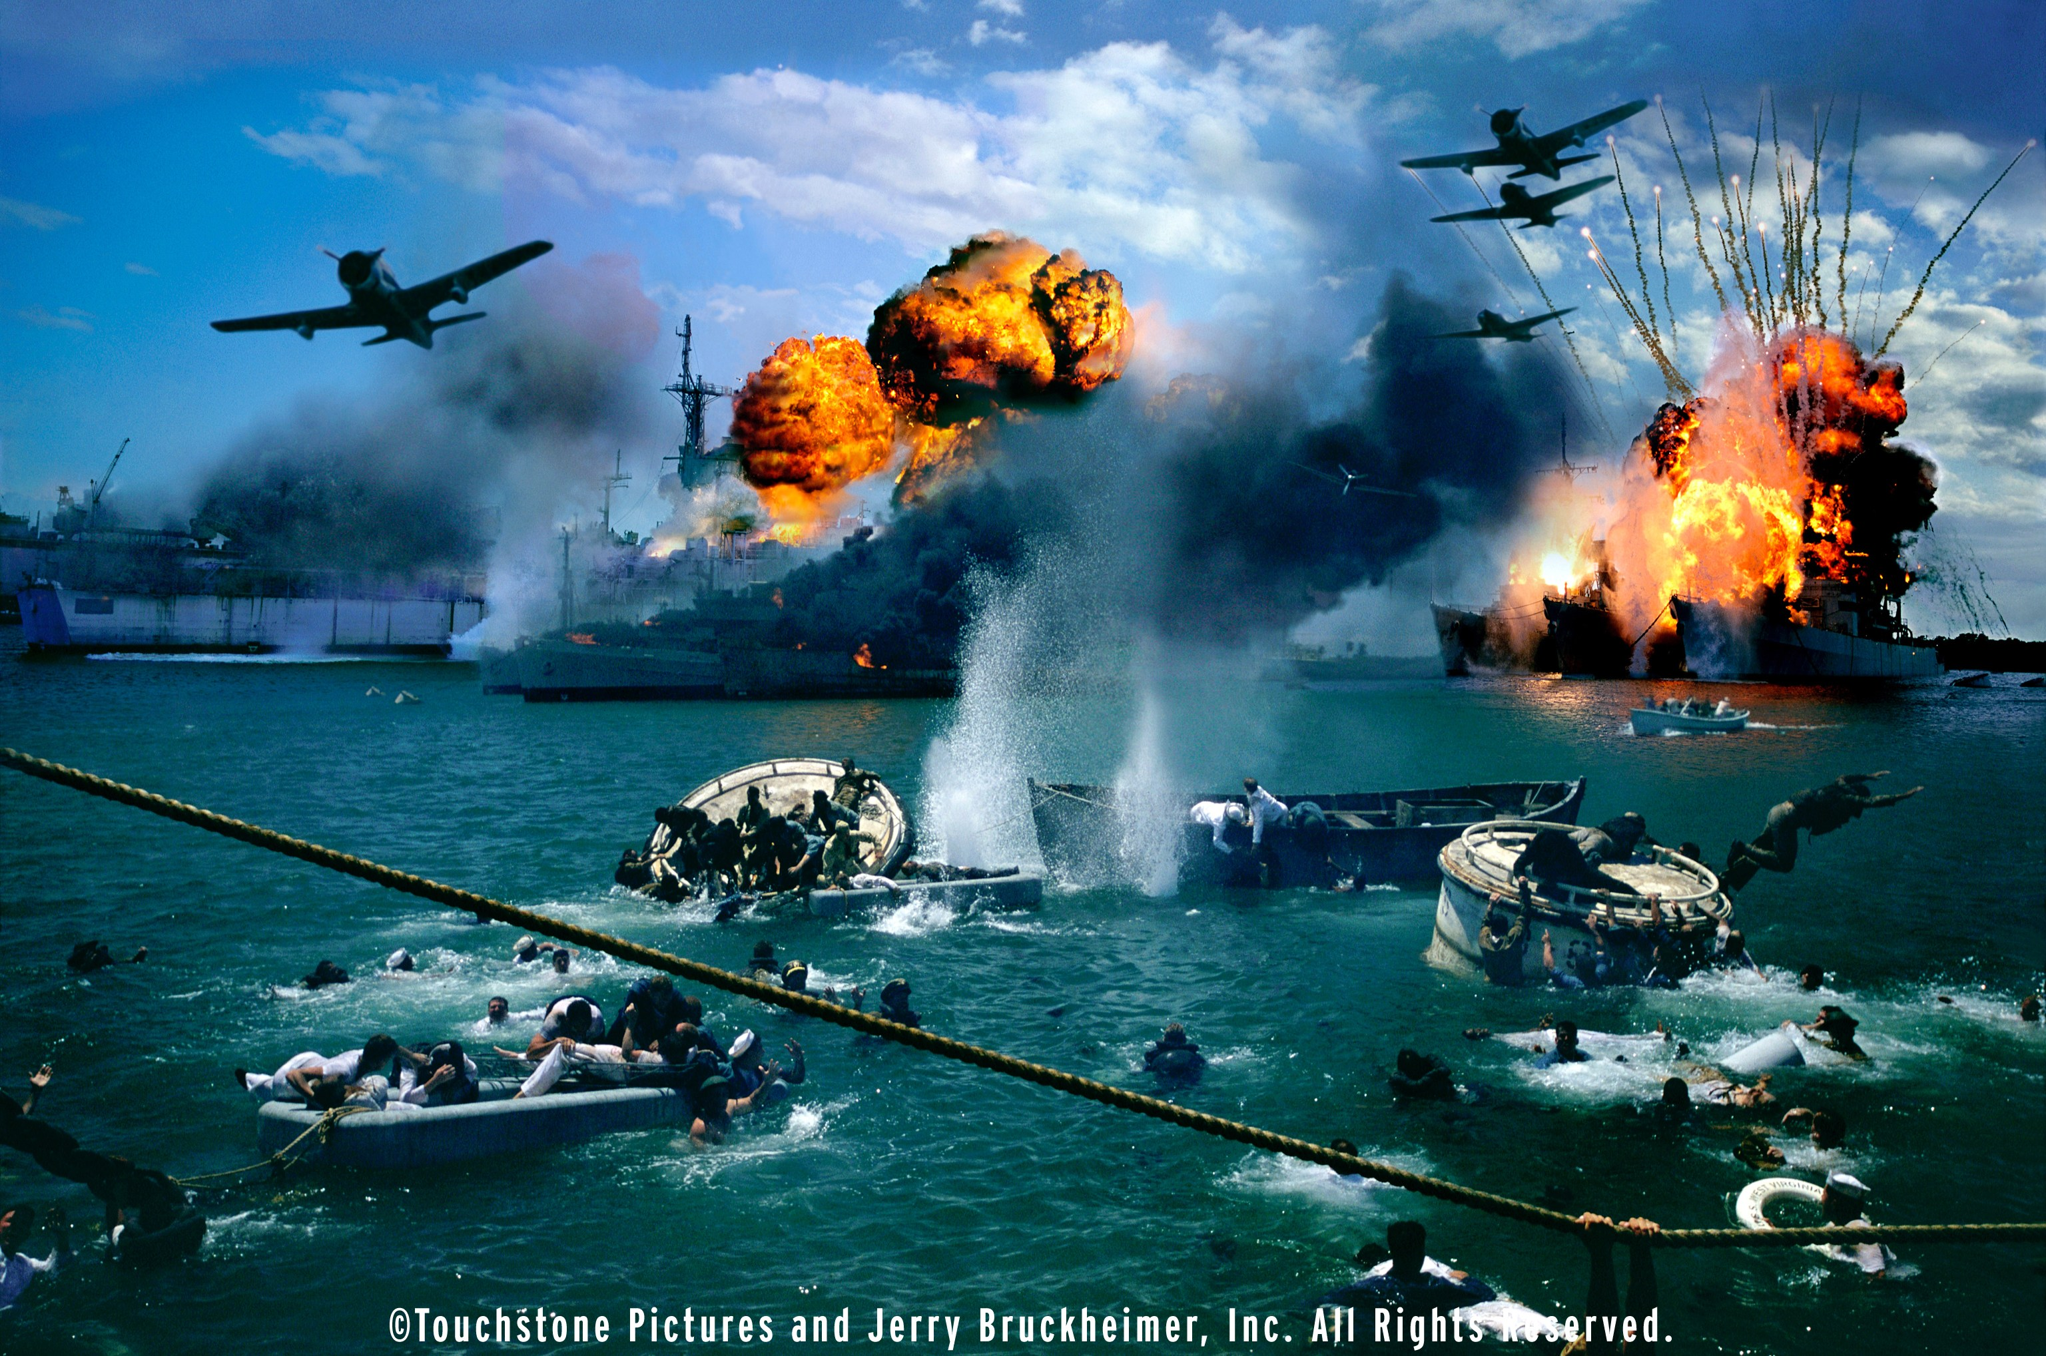
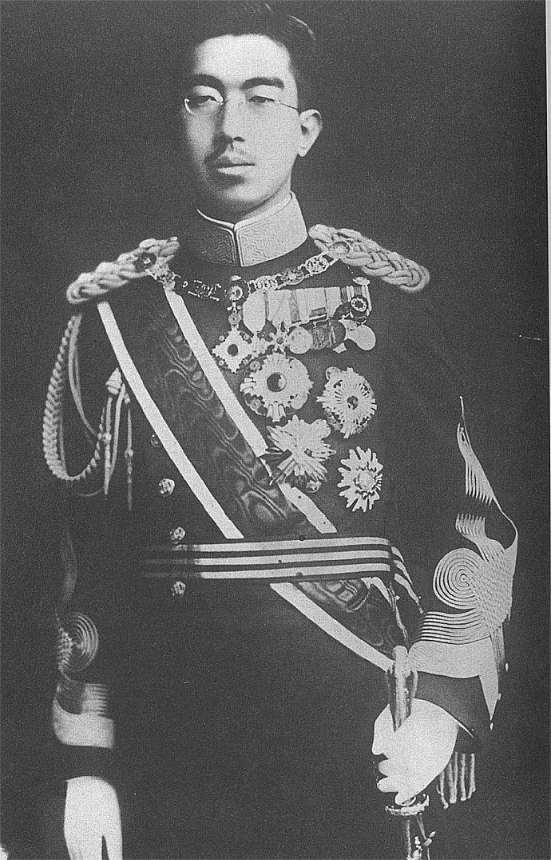
Emperor Hirohito was the man that ordered the attack on __________ which forced the US to join WWII.
Pearl Harbor

Slide 9
ANSWER: Natural Resources
What was the reason for the attack on Pearl Harbor???
HINT: (IT HAD SOMETHING TO DO WITH GEOGRAPHY)
Notes:
The next couple of slides are a comparison of the countries that we will be visiting. Notice how small all are compared to China.

Slide 10
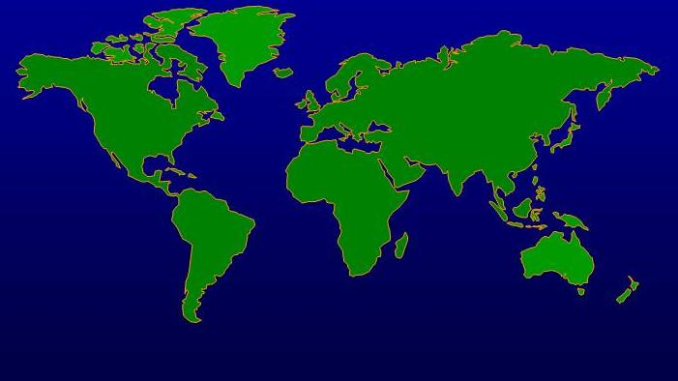
Japan’s Vision of the World
Japan
Germany & Italy
United States

Slide 11
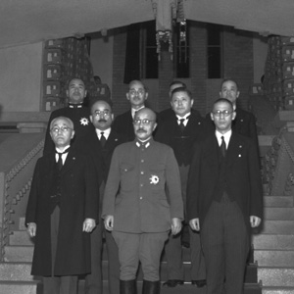
“I hear that the enemy is boasting of his demand for unconditional surrender of Japan. Unconditional surrender means that our national structure and our people will be destroyed. Against such boastful talk there is only one measure we must take, to fight to the last.” –Pr. Suzuki, 6/09/1945

Slide 12
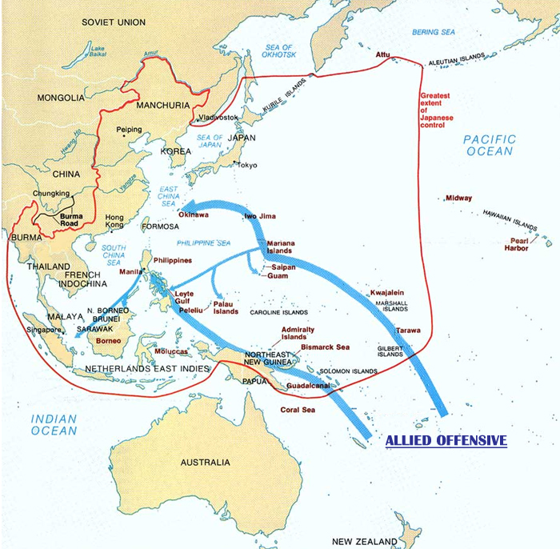
Despite great loses in men and equipment, Japan continued to fight savagely.
US fighter pilots also fought on the side of the Chinese of which they called themselves the “Fighting Tigers.”
The US flew supplies over the Himalayas to help the Nationalist Chinese fight against Japan
One by one, the US began recapturing islands from the Japanese
The US became convinced that only a direct invasion of Japan would lead to an end to the war.
The US estimated that it would lose 1 million men in the invasion

Slide 13
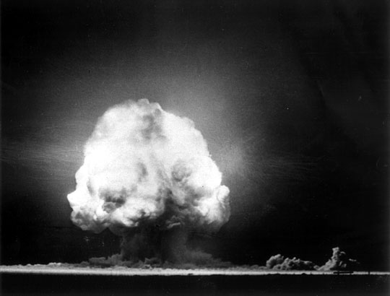
7/1945: Atomic Bomb: New US Pres. Truman notified $2 bil (08: $25 bil) bomb project successful

Slide 14
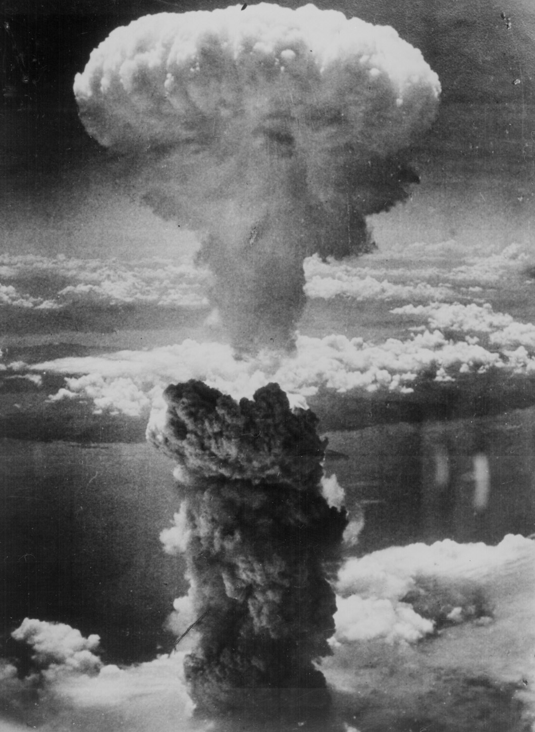
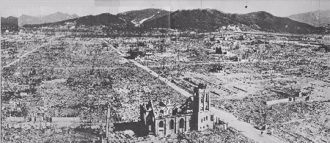
Hiroshima – August 6, 1945
70,000 killed immediately.
48,000 buildings. destroyed.
100,000s died of radiation poisoning & cancer later.

Slide 15
“We are in possession of the most destructive explosive ever devised by man. A single one of our newly developed atomic bombs is actually the equivalent in explosive power to what 2000 of our giant B-29s can carry on a single mission.
This awful fact is one for you to ponder and we solemnly assure you it is grimly accurate. We have just begun to use this weapon against your homeland. If you still have any doubt, make inquiry as to what happened to Hiroshima… we ask that you now petition the Emperor to end the war.
Our president has outlined for you the thirteen consequences of an honorable surrender.”

Slide 16
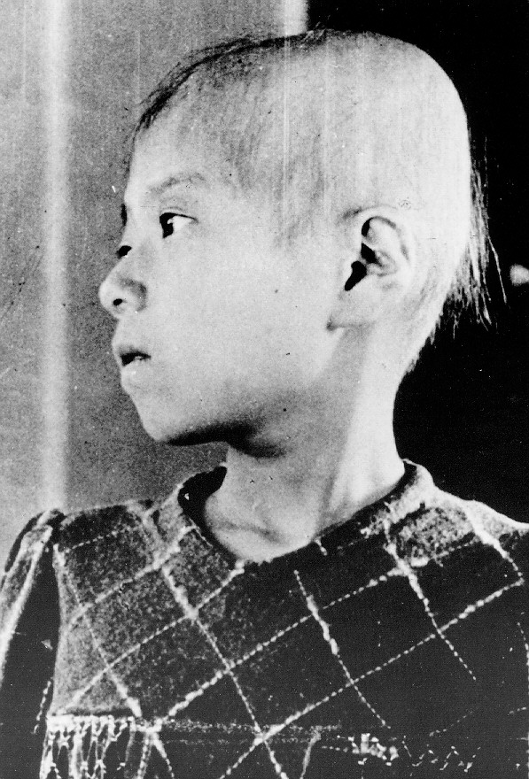
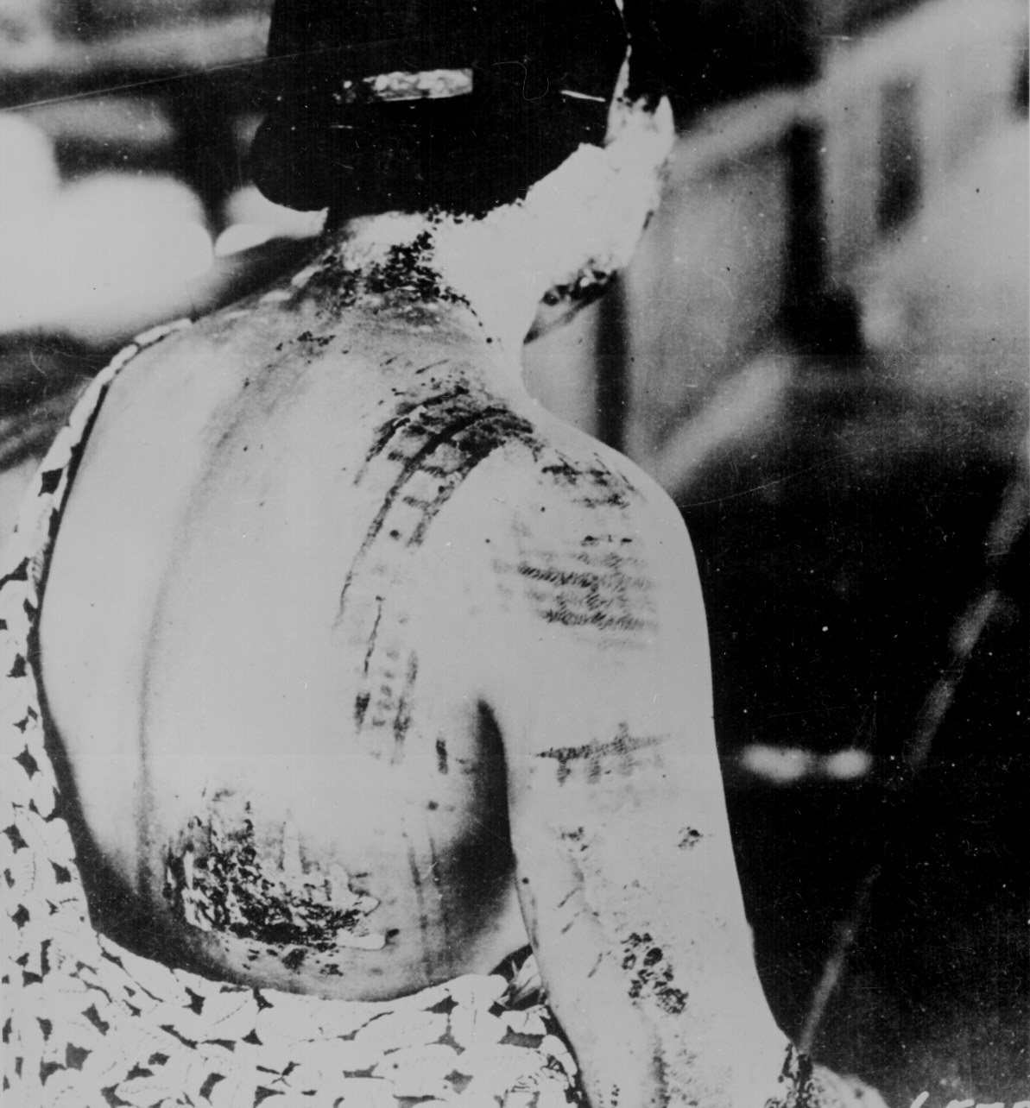
Japanese A-Bomb Survivors

Slide 17
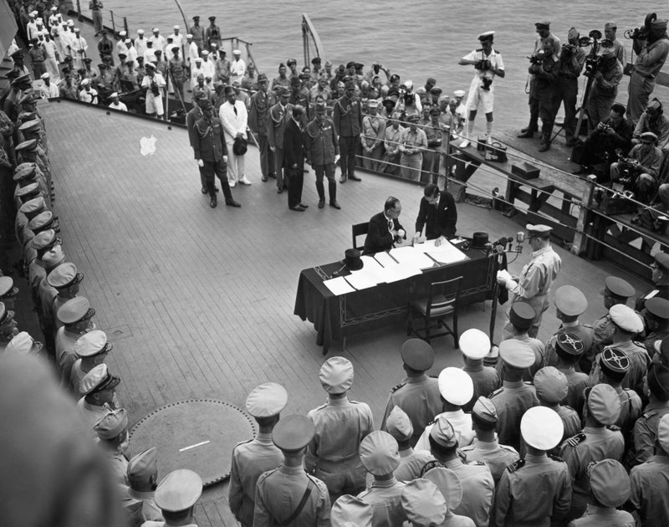
Notes #14b, Title: “WWII: Asia”
7) 8/15/1945: Japan Surrenders: Emperor Hirohito
orders surrender. US General MacArthur controls Jap.

Slide 18
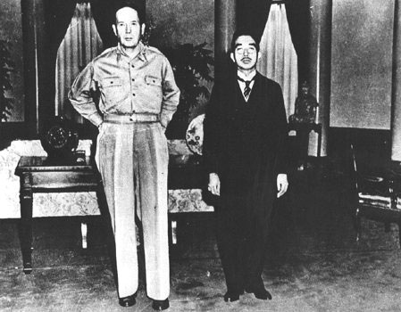
After the Destruction
MacArthur is named Supreme Allied Commander of the Pacific and begins the occupation of Japan

